Slide 1




Year 11 Parent
Information Event
Post-16 routes and options
October 2020

Slide 2
Welcome
Michelle Hogan from Own Futures
Simon Wakefield from Park Lane
Hilary Fletcher from C&K Careers
Notes:
Michelle to introduce the event and the contributors who will each briefly say hello and what their roles are in supporting the students in terms of their post-16 options

Slide 3
Purpose of the session
Find out about the different post-16 options available for your child
Learn the difference between the types institutions they can go to
Understand more about what the different levels mean
Have an understanding of the local labour market
Develop a picture of what their Year 11 is going to look like in terms of careers support and guidance
Have the opportunity to ask questions
Notes:
Michelle to go through the purpose of the session.

Slide 4
Park Lane Academy
Careers Presentation
Year 11 parents via Zoom
Hilary Fletcher 7/10/20
Notes:
The Connexions template must be used for all Connexions contracts or funded projects including all guidance teams, centres, information team and work based services.
The Corporate template should be used when presenting C&K Careers Ltd as a business; under no circumstances must this template be used when presenting a Connexions contract or funded project. For advice regarding the use of partner logos within corporate presentations please contact DTP or Customer Relations.
This presentation opens up on the View Notes page. To start working on the template, click on View and then Normal.

Slide 5
C&K Adviser’s role in school
To give students
INFORMATION
ADVICE
GUIDANCE
The next step after Year 11 The subjects they enjoy, grades, how they learn best, career ideas… GOALS
Worries they might have about leaving school
The Applications Process
Their Attitude, Attendance, Attainment, Motivation & Behaviour

Slide 6
Raising the participation age (RPA)
The ‘participation’ age was raised (2014) so that all young people in England are now required to continue in LEARNING (education or training beyond the age of 16.)
Young people have a choice about how they continue.

Slide 7
Don’t worry the choice is simple
At the end of Year 11 students will be asked to decide between
Further Education
Training A job with National Vocational Qualifications ( NVQs) added whilst learning skills.
An Apprenticeship / or work-based learning L2
OR Traineeship L1

Slide 8
Military organisations (such as the army, navy, and air force)
Michelle will talk about Apprenticeships later – but it is worth remembering that joining the ARMY – RAF – NAVY are also considered as TRAINING and are recorded as an apprenticeship.
The Army is a popular choice and Year 11s can enlist, with parental permission, we always use Careers chat services on the website https://apply.army.mod.uk/how-to-join/joining-process/soldier-recruitment– Some chose to go to The Army Foundation College in Harrogate first.

Slide 9
FURTHER EDUCATION
Because Park Lane Academy does not have a Sixth Form students who want Further Education have the following choices
Any School Sixth Form
A Sixth Form College
Any Further Education College

Slide 10
Choosing qualifications depends on students grades and learning style
Subject to GCSE grades students move onto
Level 3 courses – A* A B (&C) grades. 9/8/7/6 -5&4s
Level 2 courses– D grade 3s
Level 1 courses – E F & G grades 2 & 1
Entry Level G – grades or below.
Higher Education is Level 4

Slide 11
Sept 2020 | Oct 2020 | Nov 2020 | Dec 2020
Careers Interviews | Careers Interviews Get Organised Event VIRTUAL Open Days starts end of October! | Careers Interviews Go to Open Days | Careers Interviews Go to Open Days Watch out for deadlines!
Jan 2021 | Feb 2021 | Mar 2021 | April 2021
Watch out for deadlines! Go to Open Days Interviews start!!! | Watch out for deadlines! Interviews Start looking for an apprenticeship | Watch out for deadlines! Interviews Apprenticeship event | Hopefully all be sorted with a plan by this time. If not help is still available. Spring Bank September Guarantee recorded

Slide 12


Slide 13
Apprenticeships
Notes:
Michelle to go through some information about apprenticeships

Slide 14
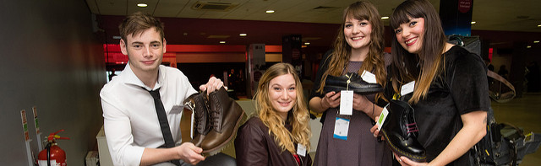
What are apprenticeships?
Earn a wage
Real job with a
real employer
Contract of employment
including holiday pay
Study towards a
job related qualification
Work for at least
30 hours per week
Notes:
Lots of people get confused about apprenticeships. That’s probably because they’ve been around for hundreds of years, but they’ve changed a lot in that time.
You will earn a wage – and it can be a really good salary too! We’ll talk more about money later on.
It’s important to understand that an apprenticeship is a real job, with a real employer. You will spend time working alongside other people and learn from their experience. There’s a myth that apprenticeships are just like work experience, where you’re given basic tasks or asked to make the tea, but this isn’t the case.
Because it’s a proper job, you will also have a contract of employment, holiday and sick pay - exactly the same as any other member of staff.
The employer will invest their time and money in helping you to gain qualifications and valuable new skills and experience.
You will be given real responsibilities and expected to work hard, just like anyone else in the company.
You will also be supported by a training provider, who will help you achieve your qualifications and make sure you complete your apprenticeship.
An apprenticeship typically takes 1 to 4 years to complete (sometimes up to 6 for some areas like Solicitor).
You will work for at least 30 hours per week and this will include paid time to complete your studies.
The total duration will depend on the delivery model that your employer selects, the level and the subject you’re studying.
As a minimum, all apprenticeships must last for a minimum of 12 months.
It’s important to remember that apprenticeships aren’t the ‘easy option’.
Holding down a full time job and studying takes a certain skill, and it won’t be right for everyone.

Slide 15





The range of apprenticeships
Accounting
Aviation
Horticulture
Architect
Creative & Digital
Teaching
Cyber Security
Surveying
Project management
Nursing
Dental Nursing
Hospitality
Hairdressing
Legal Services
Journalism
Notes:
When we talk about apprenticeships, instantly people will start to think of Plumbing, Electrical and some of the other construction trades. There are many brilliant apprenticeships in these areas, but there are also hundreds of new apprenticeships in exciting areas that you might not know exist.
The range of apprenticeship job roles out there is absolutely vast.
This slide gives you an idea of the huge range of apprenticeships available and this is just a taster
You could start an apprenticeship in hundreds of occupational areas. Some will amaze you!
Activity idea: Pick out a few of the job roles to discuss – will depend on the audience.
Activity idea: Can anyone spot an apprenticeship on the screen that has surprised them?
Activity idea: Does anyone know someone who is doing an interesting apprenticeship?

Slide 16



























Which employers offer apprenticeships?
Notes:
Note to delivery team: Please update this slide with local companies if you feel that the logos are not representative of your area
Equally, the range of employers offering apprenticeships is incredible.
This slide shows you some really familiar logos of big companies in England who all recruit apprentices. Around 50% of apprenticeships started are with large companies like this, but 50% will be with smaller local companies.
It can be tempting to think that the ‘best’ apprenticeships are just with the big, well-known companies, but many of the smaller employers have absolutely brilliant schemes that enable fast-track career progression for their apprentices so it’s really important to do your research and not to ignore smaller employers because they can be just as good.

Slide 17
The levels of apprenticeships
LEVEL
Intermediate
apprenticeship
Level 2
Advanced apprenticeship
Level 3
Higher apprenticeship
Level 4-7
Degree apprenticeship
Level 6 & 7
SKILLS, KNOWLEDGE & BEHAVIOURS
Notes:
We now have four apprenticeship levels: Intermediate, Advanced, Higher and degree
So if you want to, you can now start an apprenticeship and work all the way up to achieving a degree.
Higher apprenticeships cover all levels from 4 through to 7
Level 4, 5, 6 and 7 are equivalent to a Foundation Degree and above.
A degree apprenticeship contains a Level 6 or 7 Bachelors or Masters degree.
Which level of apprenticeship you start at will depend on the kind of job that you are applying for. It’s really important not to be held back by only looking for a particular level e.g. degree apprenticeships, because it may be that you need to start at advanced or higher level and work your way up.
Doing a job is completely different to getting a GCSE or A Level and that’s why it can be a bit confusing.
The duration of your apprenticeship will depend on a number of factors including the delivery model that your employer selects and which level of apprenticeship you are studying. As a minimum, all apprenticeships must last for a minimum of 12 months.

Slide 18
Salary
These are MINIMUM wages, employers can choose to pay more (and often do) in order to get the best candidates.
Apprenticeships are very competitive though and even if a college offers your child a place, they really need to find their own employer to guarantee being able to take it up.
Be aware, child benefit does stop if your child gets an apprenticeship.
Aged 16 to 18
The current National Minimum Wage rate for an apprentice is £4.15 per hour.
Aged 19 or over and in their first year
The current National Minimum Wage rate for an apprentice is £4.15 per hour.
Aged 19 or over and have completed their first year
Age 19 to 20 £6.45
Age 21 to 24 £8.20
Age 25 and over £8.72
Notes:
Child benefit will also stop if the child gets an apprenticeship but that is because the child will be earning a wage so could contribute to the household income

Slide 19
Labour Market

Slide 20
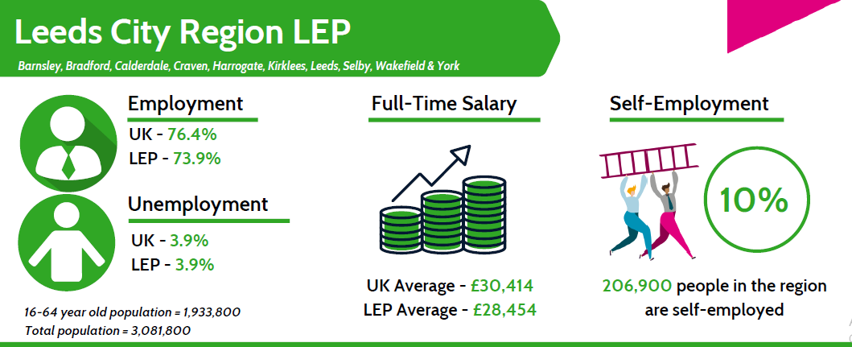
Notes:
Michelle and / or Hilary to go through. These have been updated since covid

Slide 21
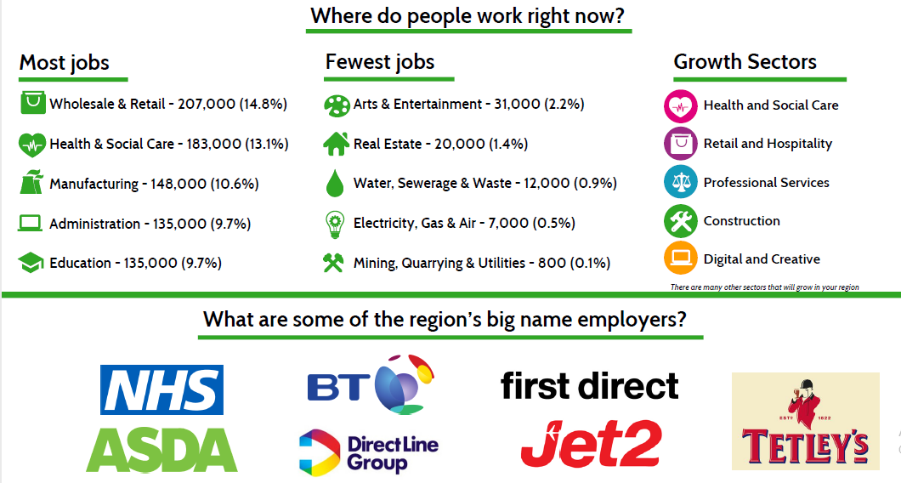

Slide 22
Support for your child during Year 11

Slide 23
So what support will you and your child get?
At least one, one-to-one meeting with Park Lane’s C&K Careers Advisor
Support with completing application forms and submitting them
C&K Advisor available during virtual parents evening
Post-16 Options morning where information about routes, levels and choices will be explained
Get Organised book with information in about open evenings, application deadlines, courses on offer
Support with writing a CV and personal statement – particularly if applying for an apprenticeship
Post-16 options afternoon, Careers Convention, Apprenticeship Day, Mock Interviews
Notes:
Simon to go through the support

Slide 24
Thank you for joining us!
Notes:
We will go through any questions that have been typed on Zoom during the session

